Slide 1

Automated Pneumonia Diagnosis with Machine Learning
Machine Learning and Data Mining
Benedetta Pacilli - Valentina Pieri
2023/2024

Slide 2
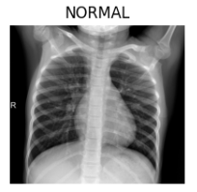
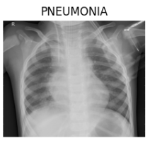
Introduction
Medical diagnosis heavily depends on X-ray images
Chest X-ray images play a crucial role in pneumonia identification
Timely detection of pneumonia is fundamental
Individuals with compromised immune systems
Prompt treatment initiation
Prevent complications
Project goal: construct a robust classifier capable of distinguishing between normal and pneumonia-affected X-ray thoracic images
Studying, employing, and evaluating various machine learning and deep learning algorithms

Slide 3
Project phases overview
Data Import
Acquisition of an adequate X-ray images dataset from Kaggle
5,863 images categorized into Pneumonia and Normal cases
Data Exploration
Comprehensive and exhaustive analysis of the dataset
Consequent identification of dataset problems
Machine Learning
Feature extraction
Training and testing different machine learning models
Deep Learning
Performing data augmentation
Building and evaluating a Convolutional Neural Network (CNN)

Slide 4






Data Import
Public dataset from Kaggle
Chest X-ray images regarding Pneumonia detection
5,863 images total
Organized into three folders: train, test, and val
Pneumonia designated as the Positive class

Slide 5
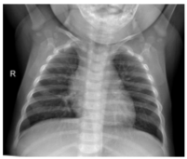
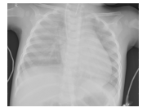
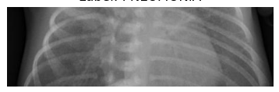

Data exploration
Better understand and prepare the dataset for the models
Balance redistribution
Images redistribution among train, test, and val
88/10/2 → 70/15/15
Images visualization to identify anomalies
Class distribution assessment
General image quality examination
Images size inspection
Brightness check

Slide 6
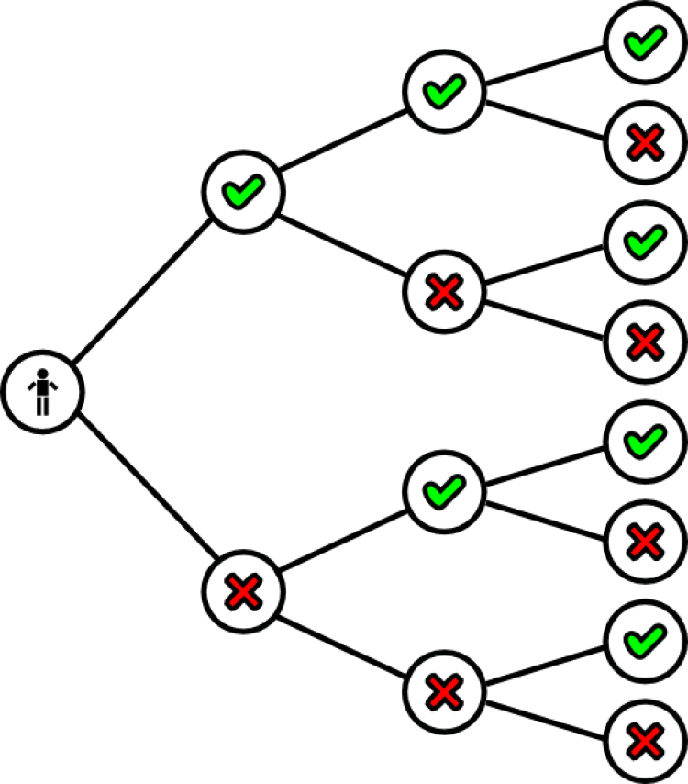
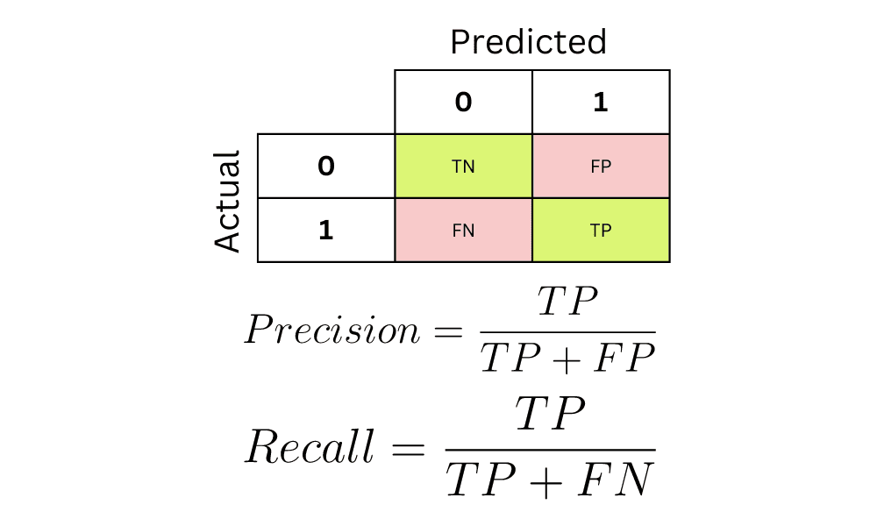
Machine Learning
Feature extraction
Histogram of Oriented Gradients (HOG)
Local Binary Pattern (LBP)
Pixel normalization
Central role in model training:
From raw image data to formats conducive to model training
Training and testing of diverse classifiers
SVM, Decision Tree, Random Forest, AdaBoost, xgBoost
Evaluation metrics
Precision, Recall, F1-Score, Confusion Matrix, Accuracy

Slide 7

Deep Learning
Preprocessing techniques
Color jittering involves random adjustments to brightness, contrast, saturation, and hue
Enhancing model robustness to different lighting conditions
Layer augmentation introduces random flips, rotations, and zooms in the images
Improving model generalization
Convolutional Neural Network (CNN) architecture
Built using tf.keras.Sequential
Layers used: Conv2D, MaxPooling2D, Dropout, Flatten, and Dense
Enable the CNN to learn complex patterns within the X-ray images
Two trainings
one on data preprocessed with color jittering
one on layers-augmented data
Evaluation metrics and methods
Precision, Recall, F1-Score, and Confusion Matrix
Plotting training loss and accuracy history over epochs

Slide 8
Results - i
Machine Learning results
Deep Learning Results
Support Vector Machine (SVM) exhibited exceptional performance with high accuracy and robustness
Followed by AdaBoost and Random Forest. They demonstrated effectiveness in identifying pneumonia cases
Slightly outperformed traditional machine learning algorithms
Inference and Robustness
Inference executions of SVM, Random Forest, and AdaBoost reflected the results obtained in the training and validation processes
The Deep Learning models, trained on different data configurations, also demonstrated high confidence in correctly classifying images from the test dataset
Conclusion
Development of robust classifiers for distinguishing between normal and pneumonia-affected X-ray thoracic images
Results achieve hold promise for automation and accuracy in pneumonia diagnosis

Slide 9
Results - ii
Machine Learning
Deep Learning
 | SVM | Decision Tree | Random Forest | AdaBoost | xgBoost
Train Accuracy | 1.00 | 1.00 | 1.00 | 0.95 | 0.84
Val Accuracy | 0.96 | 0.82 | 0.89 | 0.90 | 0.84
Test Accuracy | 0.96 | 0.81 | 0.88 | 0.90 | 0.84
Precision | 0.967 | 0.881 | 0.891 | 0.931 | 0.898
Recall | 0.976 | 0.863 | 0.957 | 0.929 | 0.874
F1-score | 0.971 | 0.872 | 0.923 | 0.930 | 0.886
 | Color Jittering | Layers Augmentation
Train Accuracy | 0.9373 | 0.9360
Train Loss | 0.165 | 0.165
Val Accuracy | 0.947 | 0.947
Val Loss | 0.149 | 0.141
Test Accuracy | 0.940 | 0.938
Test Loss | 0.164 | 0.161
Precision | 0.963 | 0.964
Recall | 0.955 | 0.959
F1-score | 0.959 | 0.961

Slide 10
Thank you for your attention

